Slide 1
GT Plant

Slide 2
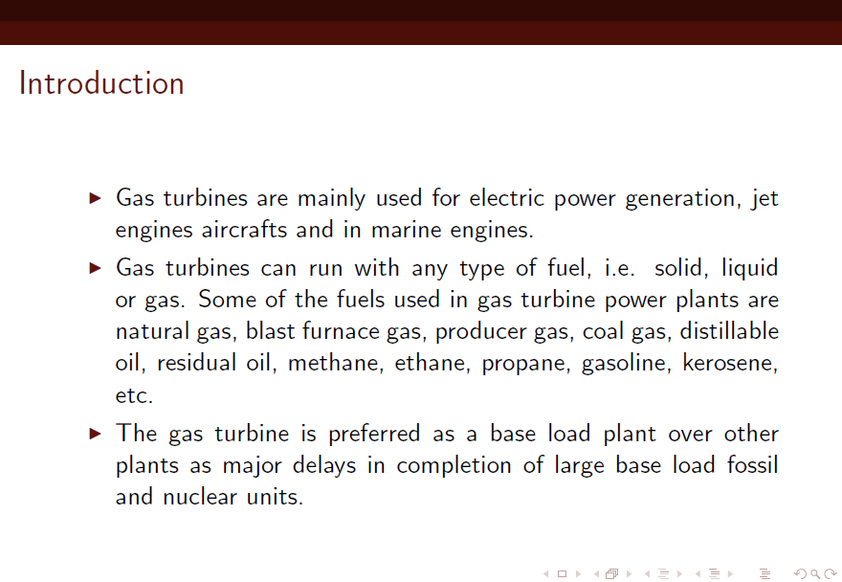

Slide 3
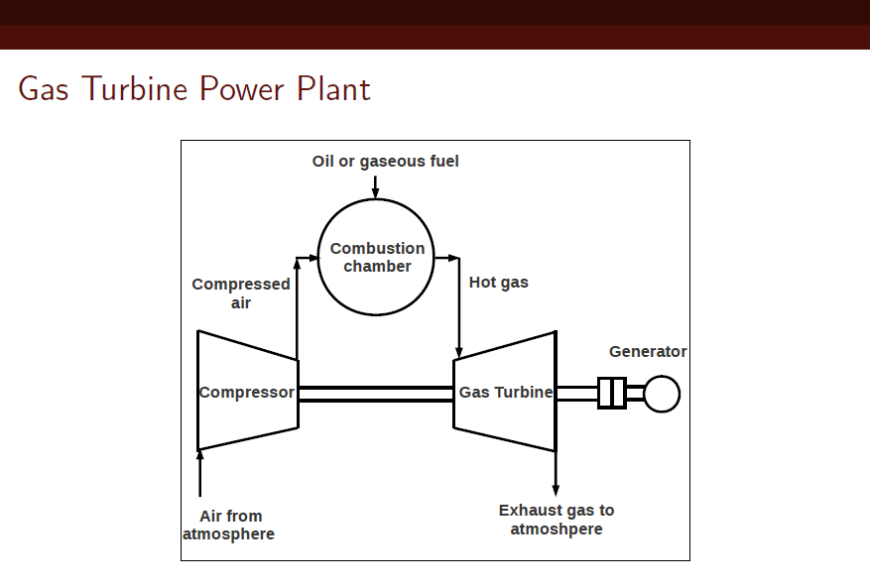
Open Cycle Gas Turbine

Slide 4
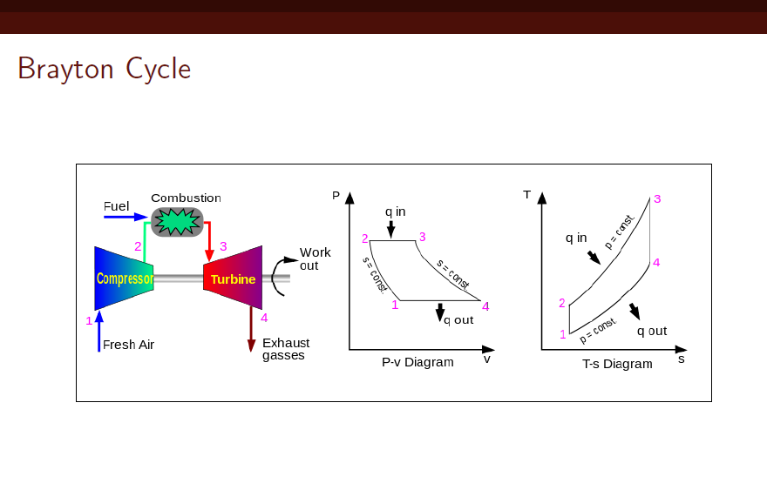

Slide 5
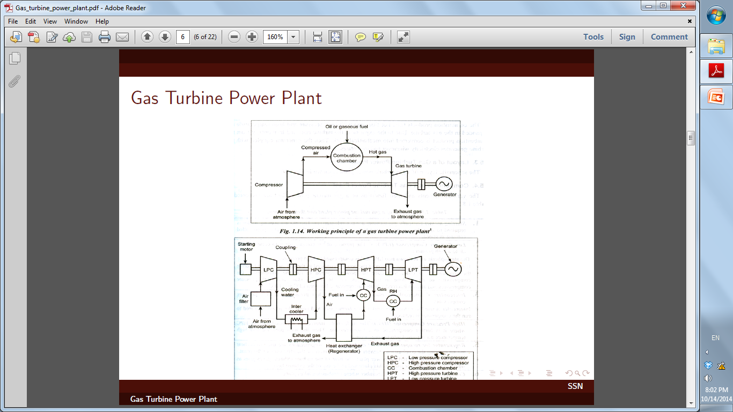

Slide 6
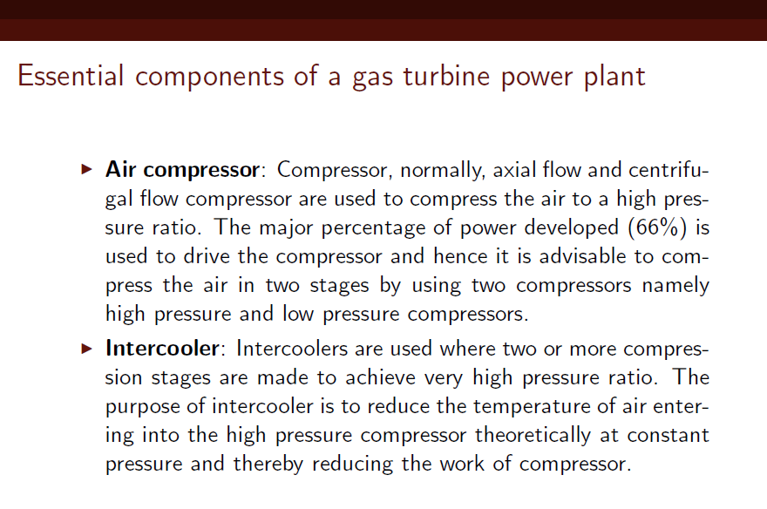

Slide 7
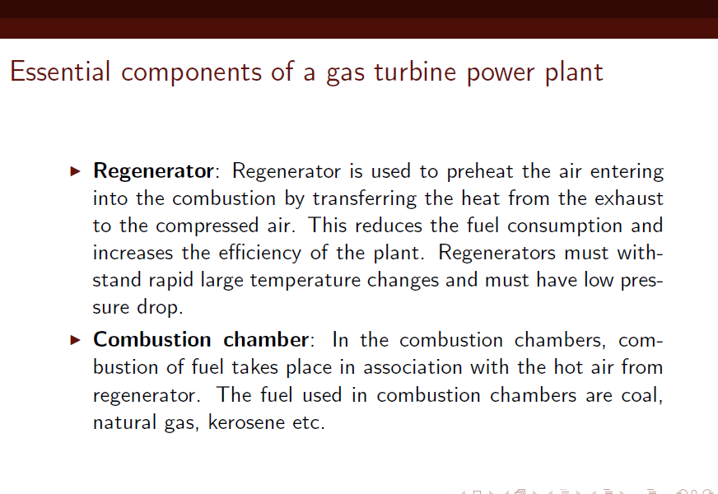

Slide 8
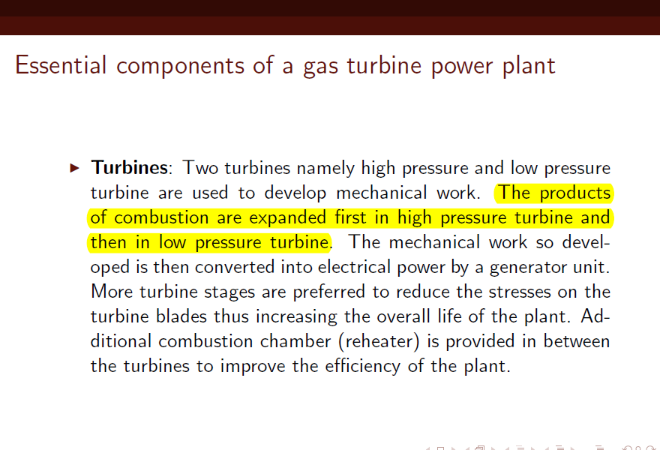

Slide 9
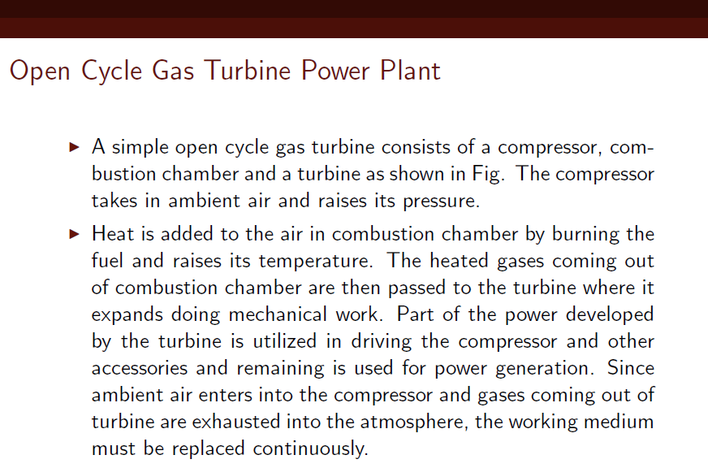

Slide 10
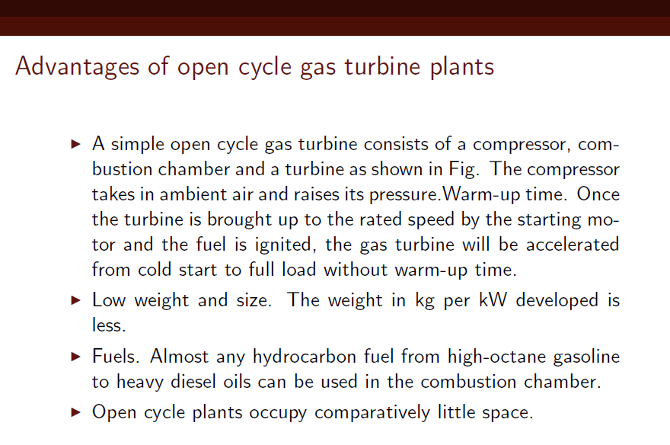

Slide 11
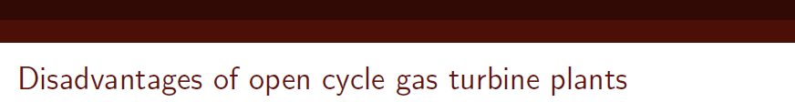
Sensitivity : The simple open cycle gas turbine is sensitive to changes in the component efficiencies. A reduction in the efficiencies of compressor and turbine will rapidly lower the efficiency of the cycle.
The open cycle gas turbine is sensitive to changes in the atmospheric temperature. An increase in atmospheric temperature lowers the thermal efficiency.
High air rate: Simple open cycle gas turbine has a very high air rate. This high air rate is not a disadvantage in most of the applications like a aviation field but is a prime factor in marine applications.

Slide 12
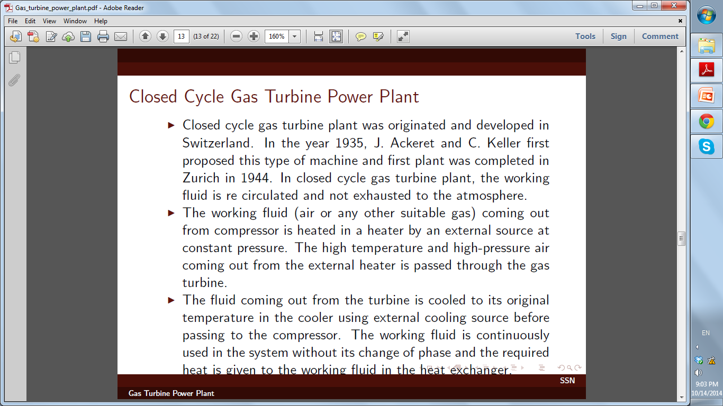

Slide 13
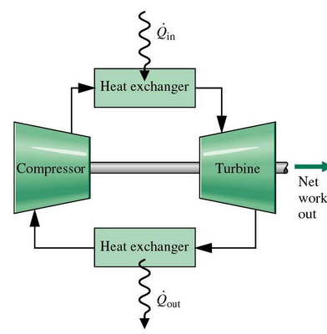
The working fluid (air or any other suitable gas) coming out from compressor is heated in a heater by an external source at constant pressure.
The fluid coming out from the turbine is cooled to its original temperature in the cooler using external cooling source before passing to the compressor.

Slide 14
Closed Cycle Gas Turbine
Advantages
Disadvantages
For a given output the size of the Compressor and the Turbine are very small
There is no Corrosion
Any Fuel of High Calorific Value may be used, as the products of combustion do not mix with the working fluid
External furnace for combustion process
More complicated and costly
System must be strong enough to resist high pressures
Coolant is used for pre-cooling whereas no coolant is required in open cycle gas turbine. Atmosphere act as sink

Slide 15
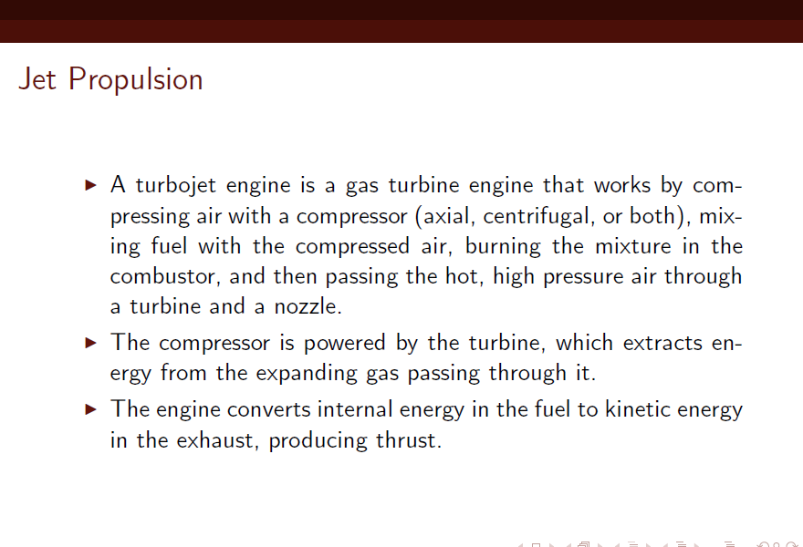

Slide 16
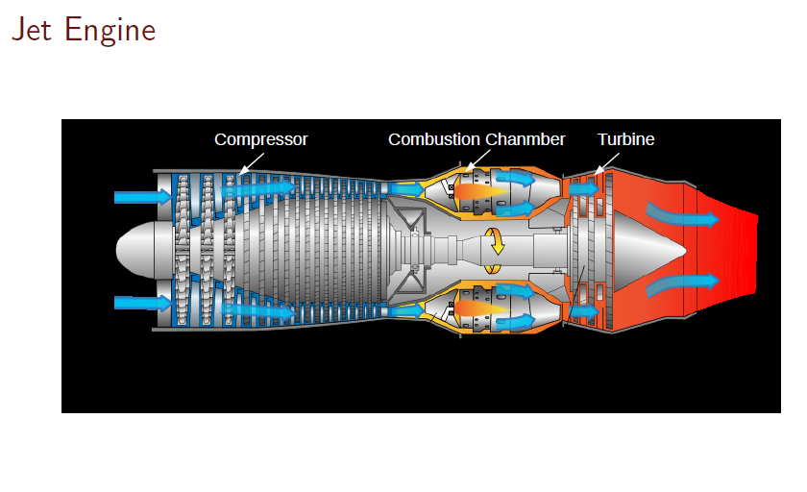
(Turbojet)

Slide 17
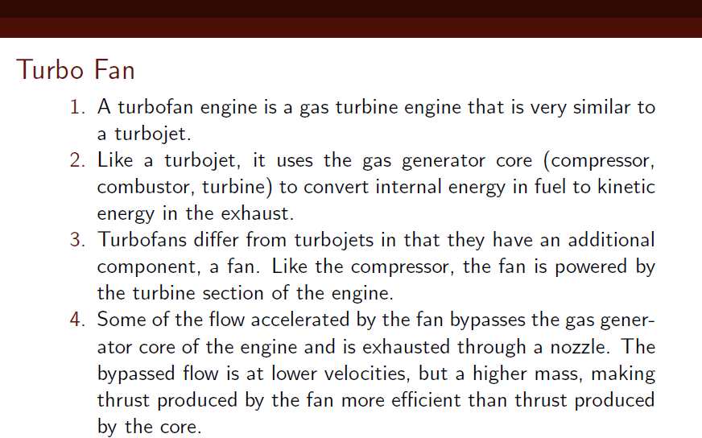

Slide 18
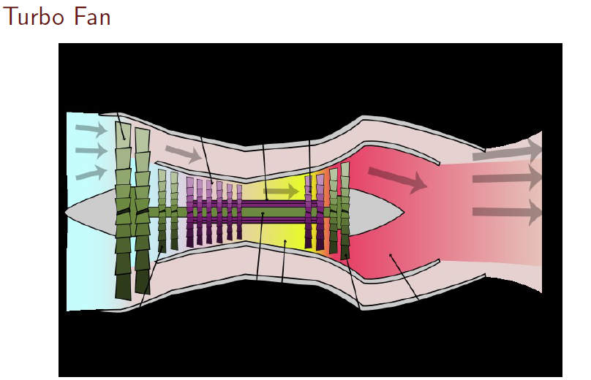

Slide 19
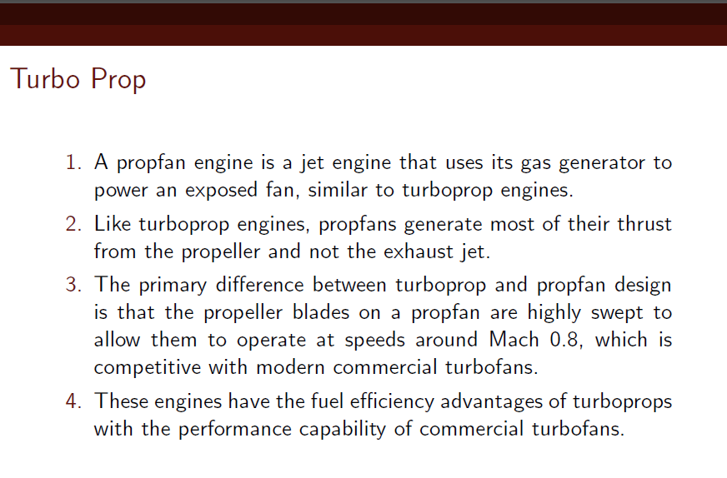

Slide 20
